Slide 1



FACULTY OF INFORMATION TECHNOLOGY
Title: Graduation Project Seminar I
Misr University for Science and Technology
College of Information Technology
A Graduation Project Report Submission in Partial Fulfillment of the Requirements for the award of the degree
Bachelor of Information Technology
FAIR: A Computer Vision System for Fair Talent Discovery
Under Supervision of
Prof. Dr. Elsayed Badr
T.A Aya Taha

Slide 2

Agenda
Introduction
Problem Definition
Project Objectives
Related Works
Proposed System
System Architecture
Software Process Model
UML
UI/UX Design
Implementation Tools
Expected Outcome (Including SDGs)
Project Plan (Gantt Chart)
Conclusion
References (IEEE Format)

Slide 3
Introduction
In the traditional process of discovering talented athletes, scouts and coaches rely heavily on physical tryouts and in-person evaluations. This method is not only time-consuming but also inefficient, as it often fails to give equal attention to every participant. Thousands of athletes compete for limited opportunities, making it nearly impossible for coaches to identify every promising talent. This outdated approach is further compounded by the high costs and physical exhaustion associated with tryouts, creating barriers for young athletes to showcase their potential.
Talent Vision introduces a revolutionary, modern approach to talent discovery by leveraging the power of a mobile app equipped with cutting-edge technology. Designed to address the inefficiencies of the traditional system, Talent Vision transforms the scouting process into an accessible, fair, and data-driven experience. The app will cater to multiple sports, making it a versatile tool for discovering talent across various athletic disciplines.

Slide 4
Problem Definition.
The current athletic tryout process is riddled with inefficiencies that limit its effectiveness. The key problems include:
Overcrowded Tryouts: Thousands of athletes compete for limited attention, making it challenging for scouts to identify promising talents. This leads to many potential stars being overlooked.
Limited Attention: Scouts struggle to effectively evaluate each athlete in the limited time available, which often results in unfair or incomplete assessments.
Costly and Exhausting Process: The traditional tryout process is expensive for athletes who need to travel and exhausting due to the physical and mental toll of multiple tryouts. These factors hinder their performance and motivation.

Slide 5
Project Objectives
Talent Vision combines its objectives with innovative features to address the inefficiencies of traditional tryouts and modernize the scouting process:
Revolutionize Talent Discovery with Video Upload & Analysis: Athletes can record and upload videos of their skills and performance, eliminating the need for physical tryouts. This ensures that all athletes have equal opportunities to be seen by scouts.
Democratize Access Through Multi-Sport Support: The app supports multiple games, ensuring inclusivity across various athletic disciplines. Every athlete, regardless of location or financial status, can participate in the scouting process.
Enhance Evaluation Accuracy with Performance Feedback Using AI: The app employs AI algorithms to analyze video footage, providing scouts with objective insights into an athlete’s technique, potential, and areas for improvement. This technology eliminates bias and enhances the accuracy of evaluations.
Foster Growth Through Progress Tracking: Athletes can monitor their development over time through data-driven insights, helping them identify strengths and areas to work on. This feature helps athletes stay motivated and continuously improve.
Promote Collaboration with Professional Insights: Collaborations with professional coaches and athletes enable the app to provide valuable feedback and guidance, fostering growth and development among young athletes.

Slide 6
Related Works
1. Hudl
Objectives:
Provide athletes with a platform to upload and share gameplay videos.
Enable coaches to analyze player performance and create highlight reels.
Facilitate collaboration between teams, athletes, and scouts.
Development Tools:
Backend: Python, Node.js.
Frontend: React.js.
Video Processing: FFmpeg.
Cloud Storage: AWS for scalable video storage and retrieval.
AI/ML: Custom-built algorithms for video tagging and analysis.
Advantages:
Comprehensive platform for video analysis and sharing.
Widely used by professional and amateur athletes alike.
Strong focus on team collaboration.
Disadvantages:
Primarily focused on team sports like football and basketball.
Requires subscription fees, limiting accessibility for underprivileged athletes.

Slide 7
Related Works
2. Coach's Eye
Objectives:
Offer athletes and coaches a tool for slow-motion video review.
Improve technical feedback through video annotations and analysis.
Development Tools:
Mobile App Framework: Swift (iOS) and Kotlin (Android).
Video Playback: OpenGL for frame-by-frame analysis.
Cloud: Google Firebase for data storage and sharing.
Advantages:
User-friendly interface with powerful video annotation tools.
Great for individual feedback during training.
Disadvantages:
Limited to video analysis without AI insights.
Requires manual annotations, which can be time-consuming..

Slide 8
Related Works
3. Dartfish
Objectives:
Provide athletes and coaches with video tagging and motion analysis.
Enable data-driven feedback for performance improvement.
Development Tools:
Video Analysis: Custom algorithms for motion tracking.
Data Storage: On-premise and cloud-based storage options.
Cross-platform App Development: Java and C#.
Advantages:
Highly detailed analysis, especially useful for technical sports.
Supports tagging specific moments in videos for precise feedback.
Disadvantages:
Expensive and targeted towards professional sports organizations.
Steeper learning curve for new users.

Slide 9
Related Works
4. HomeCourt (Basketball Focused)
Objectives:
Use AI to analyze basketball training sessions and provide performance feedback.
Track stats like shooting accuracy, speed, and positioning.
Development Tools:
AI Frameworks: TensorFlow and PyTorch for motion detection.
Video Processing: OpenCV.
Cloud Infrastructure: Google Cloud for real-time processing.
Advantages:
Highly specialized for basketball players.
Real-time AI-based performance analysis.
Disadvantages:
Restricted to basketball; not suitable for other sports.
Requires high-quality cameras for accurate analysis.

Slide 10
Proposed System
Objectives:
Empower Athletes:
Provide a platform where athletes can easily showcase their talent and abilities to scouts and coaches without the need for costly and overcrowded tryouts.
Leverage AI for Talent Evaluation:
Utilize advanced AI algorithms to objectively analyze athlete performances, eliminating human bias and enhancing accuracy in talent identification.
Promote Inclusivity:
Support athletes across multiple sports, particularly focusing on the Arabian community, while ensuring the system is accessible to both technical and non-technical users.
Reduce Barriers:
Create a free, user-friendly application that eliminates financial, geographical, and technical barriers for athletes, allowing greater participation from underprivileged areas.
Facilitate Athlete Development:
Provide tools for athletes to track their progress over time, receive professional insights, and identify areas for improvement.

Slide 11
Proposed System
System Functionalities:
Video Upload and Sharing:
Athletes can upload videos showcasing their skills and performances directly through the app.
Videos are stored securely and made accessible to scouts and coaches.
AI-Based Performance Analysis:
The app uses machine learning and deep learning algorithms to evaluate uploaded videos.
Provides detailed feedback on technique, performance metrics, and areas for improvement.
Progress Tracking:
Allows athletes to monitor their skill development over time using data visualizations and historical records.
Highlights achievements and tracks improvements to motivate athletes.
Multi-Sport Support:
Covers various sports, ensuring inclusivity for athletes from different disciplines.
Collaborative Insights:
Enables professional coaches and athletes to provide personalized feedback on submitted videos.
User-Friendly Design:
Designed for both technical and non-technical users, ensuring ease of use for athletes of all backgrounds.
Supports Arabic and other languages for regional accessibility.
Community Integration:
A social aspect where athletes can connect with peers, coaches, and scouts.
Allows scouts to easily search for talent within their required parameters.
Free and Accessible Platform:
Available on all major platforms (iOS, Android, and Web).
No subscription or hidden fees, making it accessible to all athletes.

Slide 12
Proposed System
Advantages :
Accessibility:
Free for all users, removing financial barriers for young athletes.
Available on multiple platforms, ensuring usability for a wide audience.
Inclusivity:
Supports athletes from all sports and communities, especially focusing on the underserved Arabian region.
Designed to accommodate both technical and non-technical users.
Efficiency:
Eliminates the need for physical tryouts, saving time and resources for athletes and scouts.
AI-based analysis provides faster and more accurate evaluations than traditional methods.
Objectivity:
AI removes human biases in the talent evaluation process, ensuring fair and data-driven assessments.
Development-Oriented:
Progress tracking and professional insights help athletes identify their strengths and weaknesses, motivating continuous improvement.
Scalable Solution:
Can expand to support new sports, regions, or features based on user demand.
Integrates seamlessly with modern technologies for future updates.
Community Impact:
Empowers young athletes, fostering a culture of opportunity and growth in sports.
Bridges the gap between raw talent and professional scouting opportunities.

Slide 13
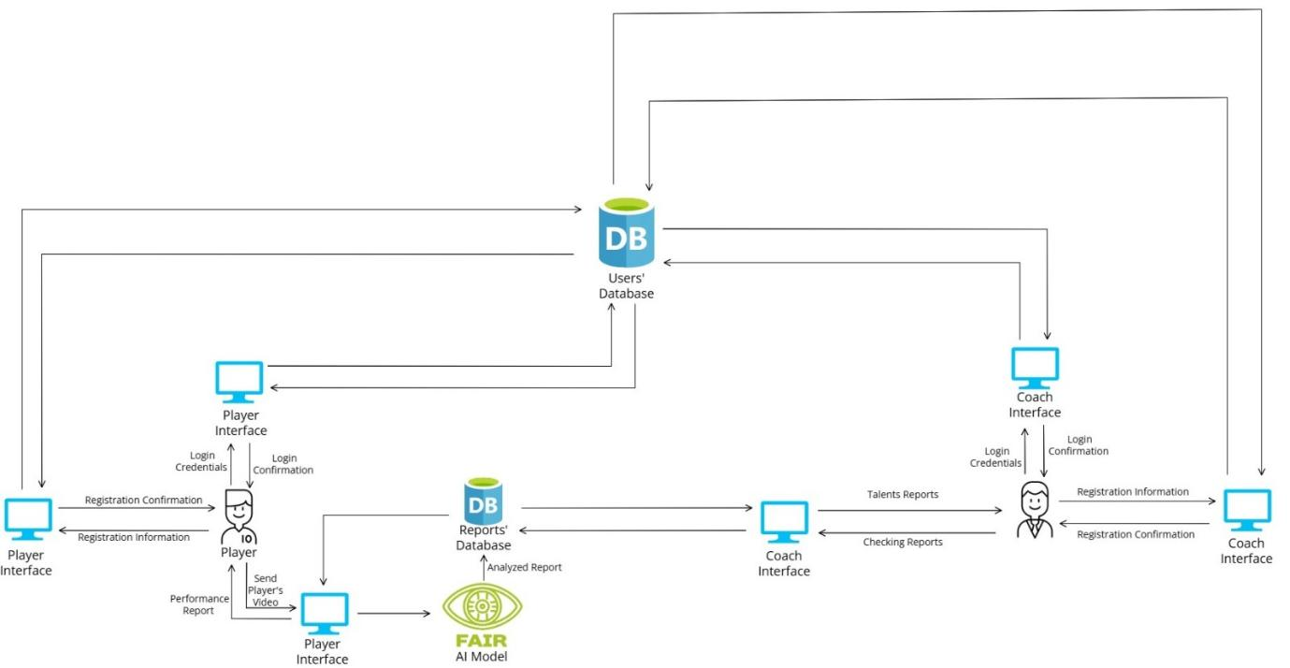
System Architecture

Slide 14
Software Process Model
Agile Model
Overview
Software Development Life Cycle (SDLC) model, The Agile Model is a highly flexible and iterative approach to software development, focusing on collaboration, customer feedback, and rapid delivery of functional software. It emerged as an alternative to traditional models like Waterfall, which are more rigid and sequential. Agile methodologies were formally introduced in 2001 through the Agile Manifesto, emphasizing principles such as individuals and interactions, working software, customer collaboration, and responding to change.
Steps
Planning: Define iteration goals.
Design: Create basic designs.
Development: Build the features.
Testing: Test the iteration.
Evaluation: Collect feedback for the next cycle.
Strengths
Flexibility for changes
Early issue detection
Continuous improvement
Weaknesses
Time-consuming
Risk of scope creep
Resource-heavy
When to Use
Evolving requirements
Frequent feedback needed
Complex projects
Why Use
Adapts to changes
Improves quality through iterations

Slide 15
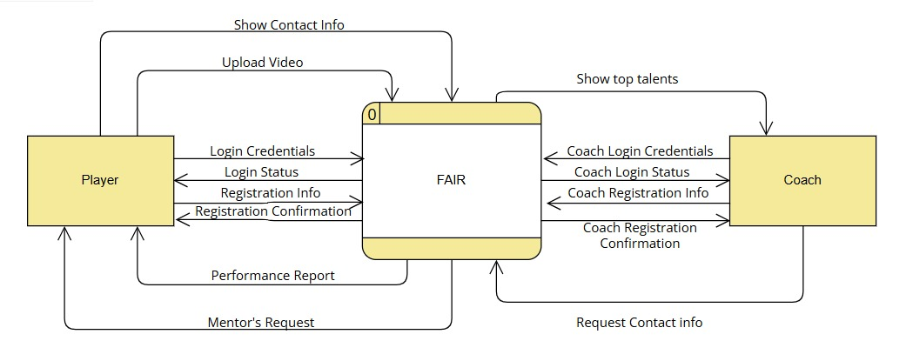
UML (Context Diagram)

Slide 16
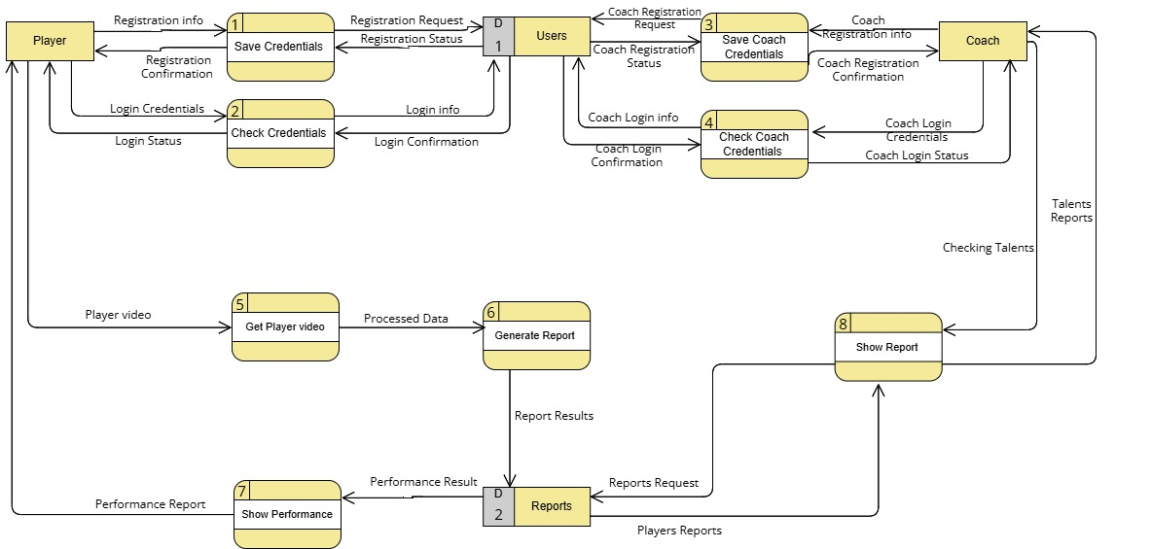
UML (Level 0)

Slide 17
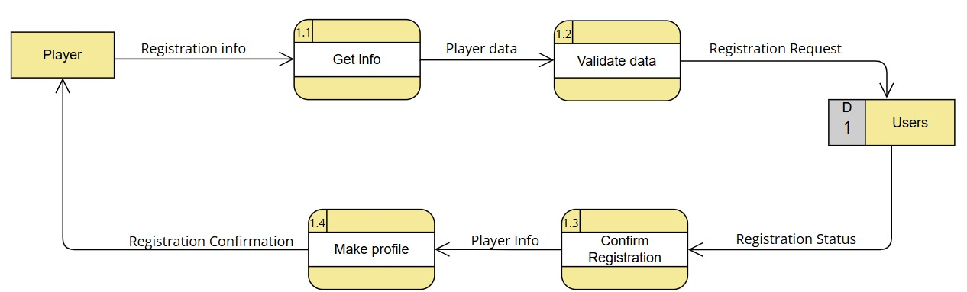
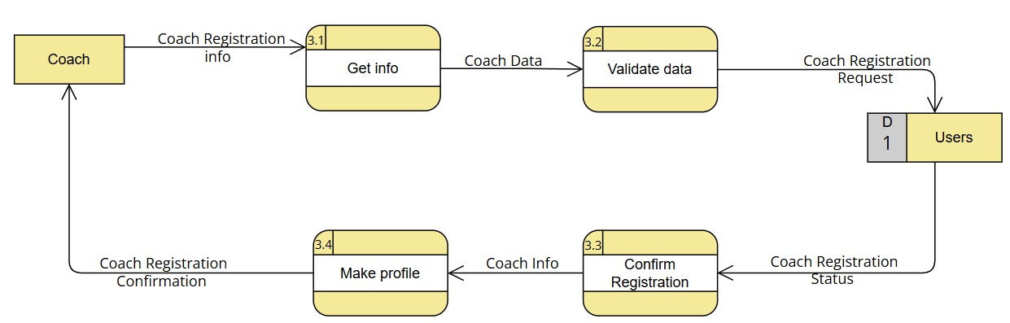
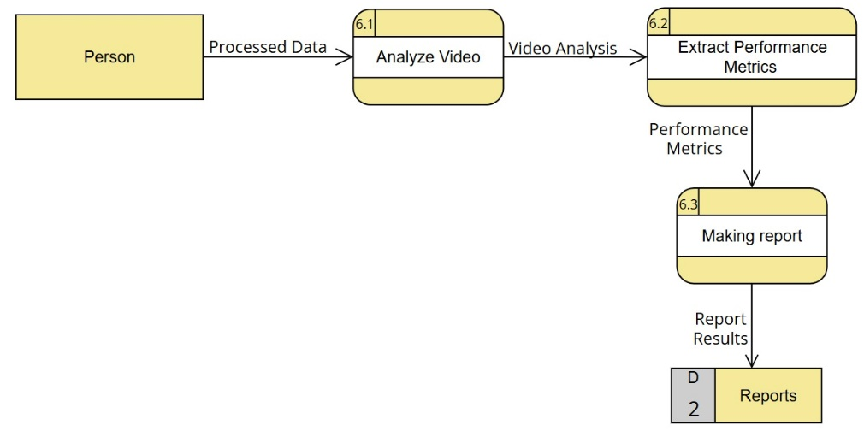
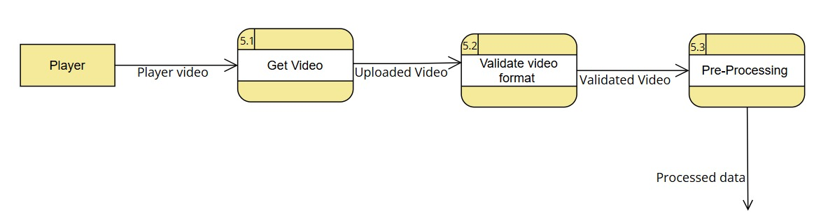
UML (Level 1)

Slide 18
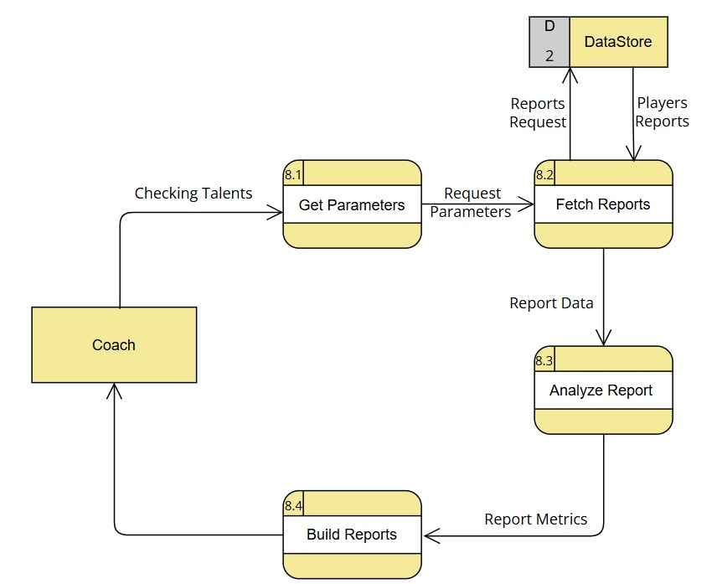
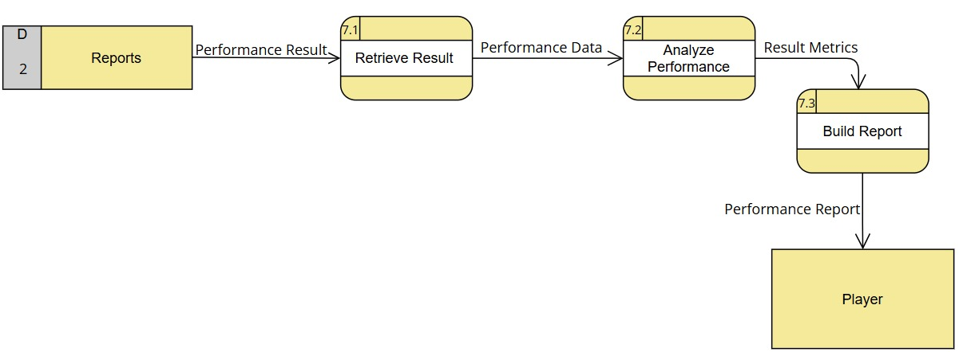
UML (Level 1)

Slide 19
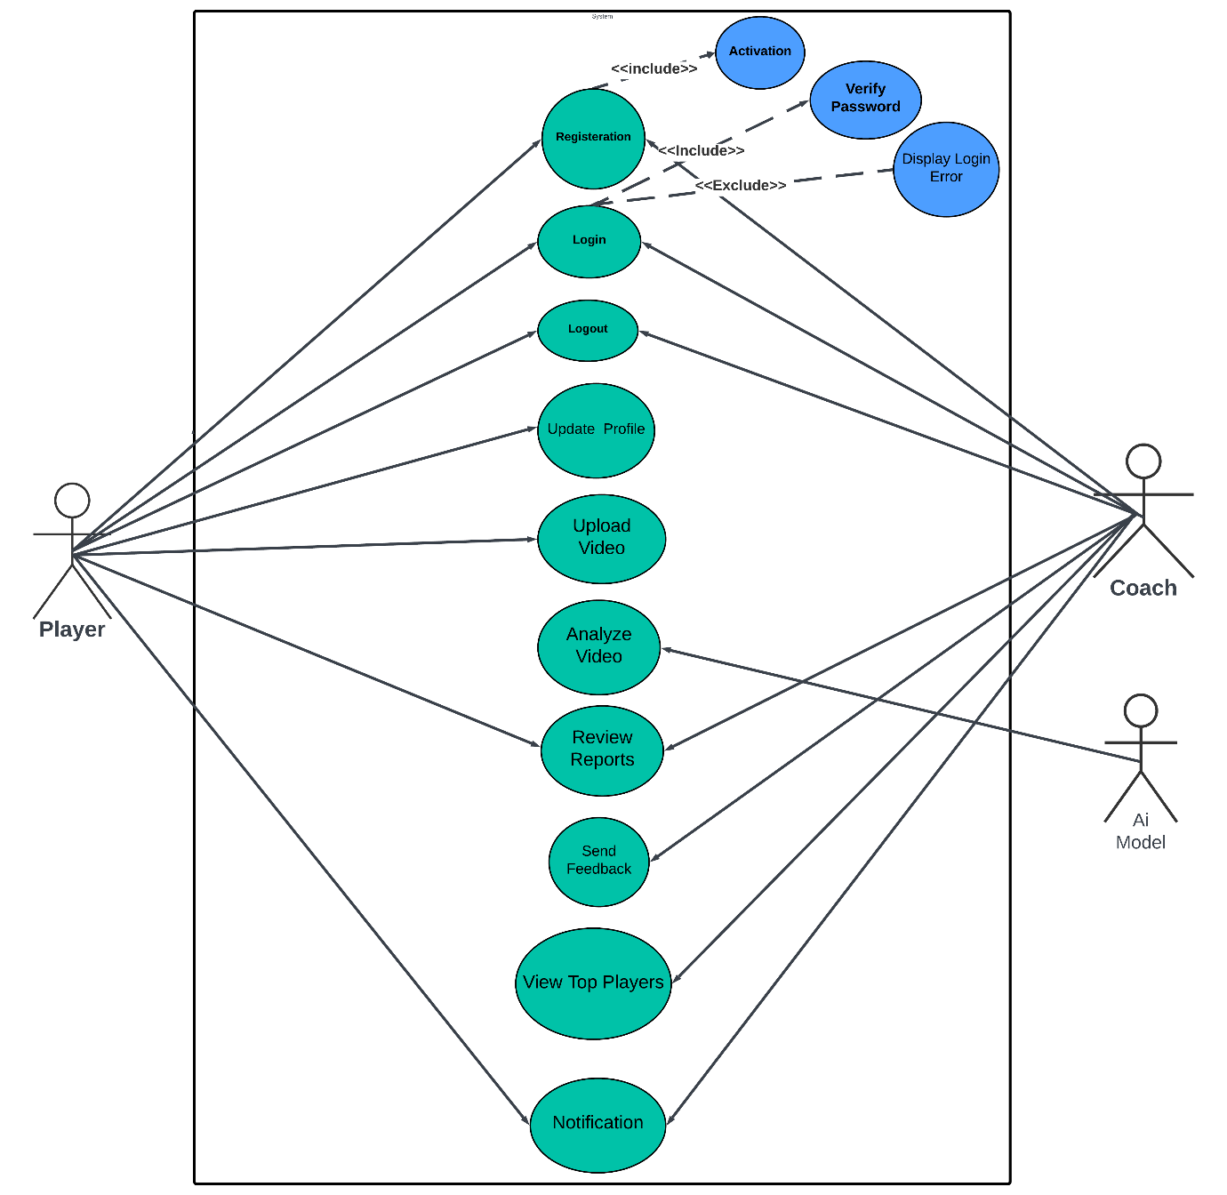
UML (Use Case Diagram )

Slide 20
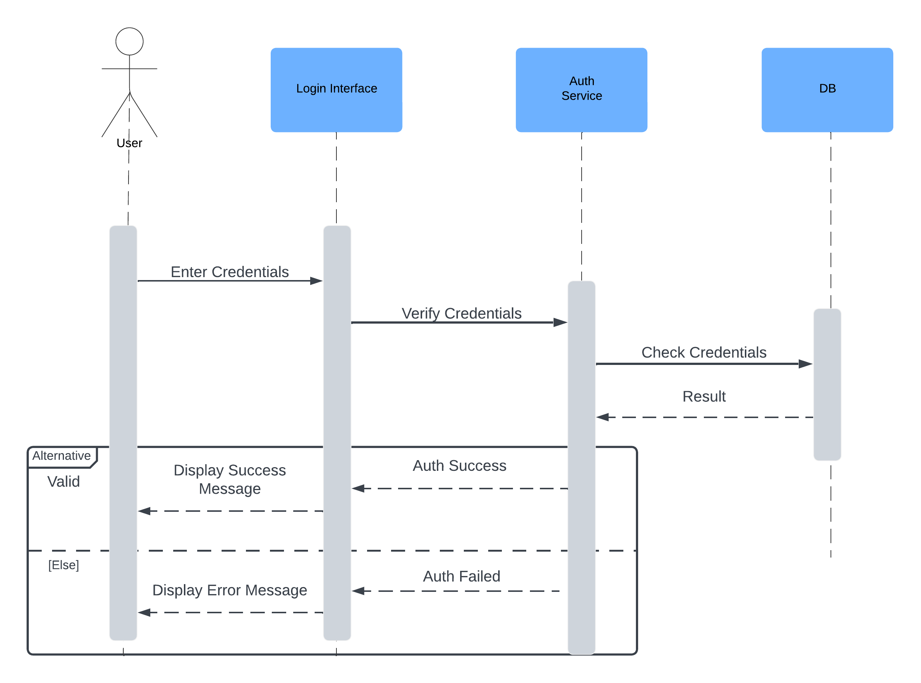
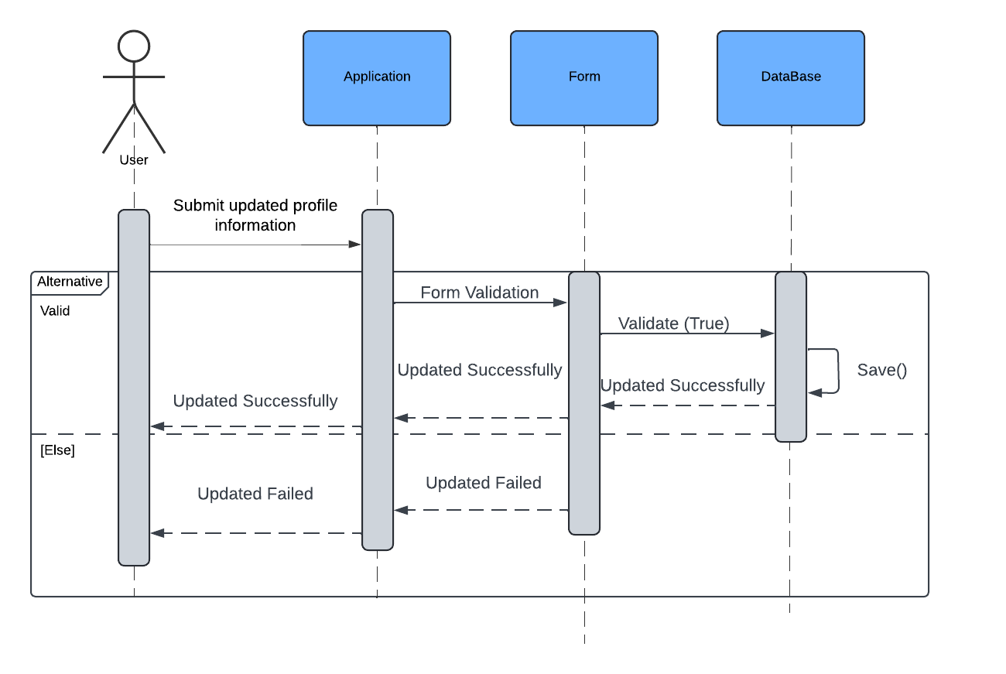
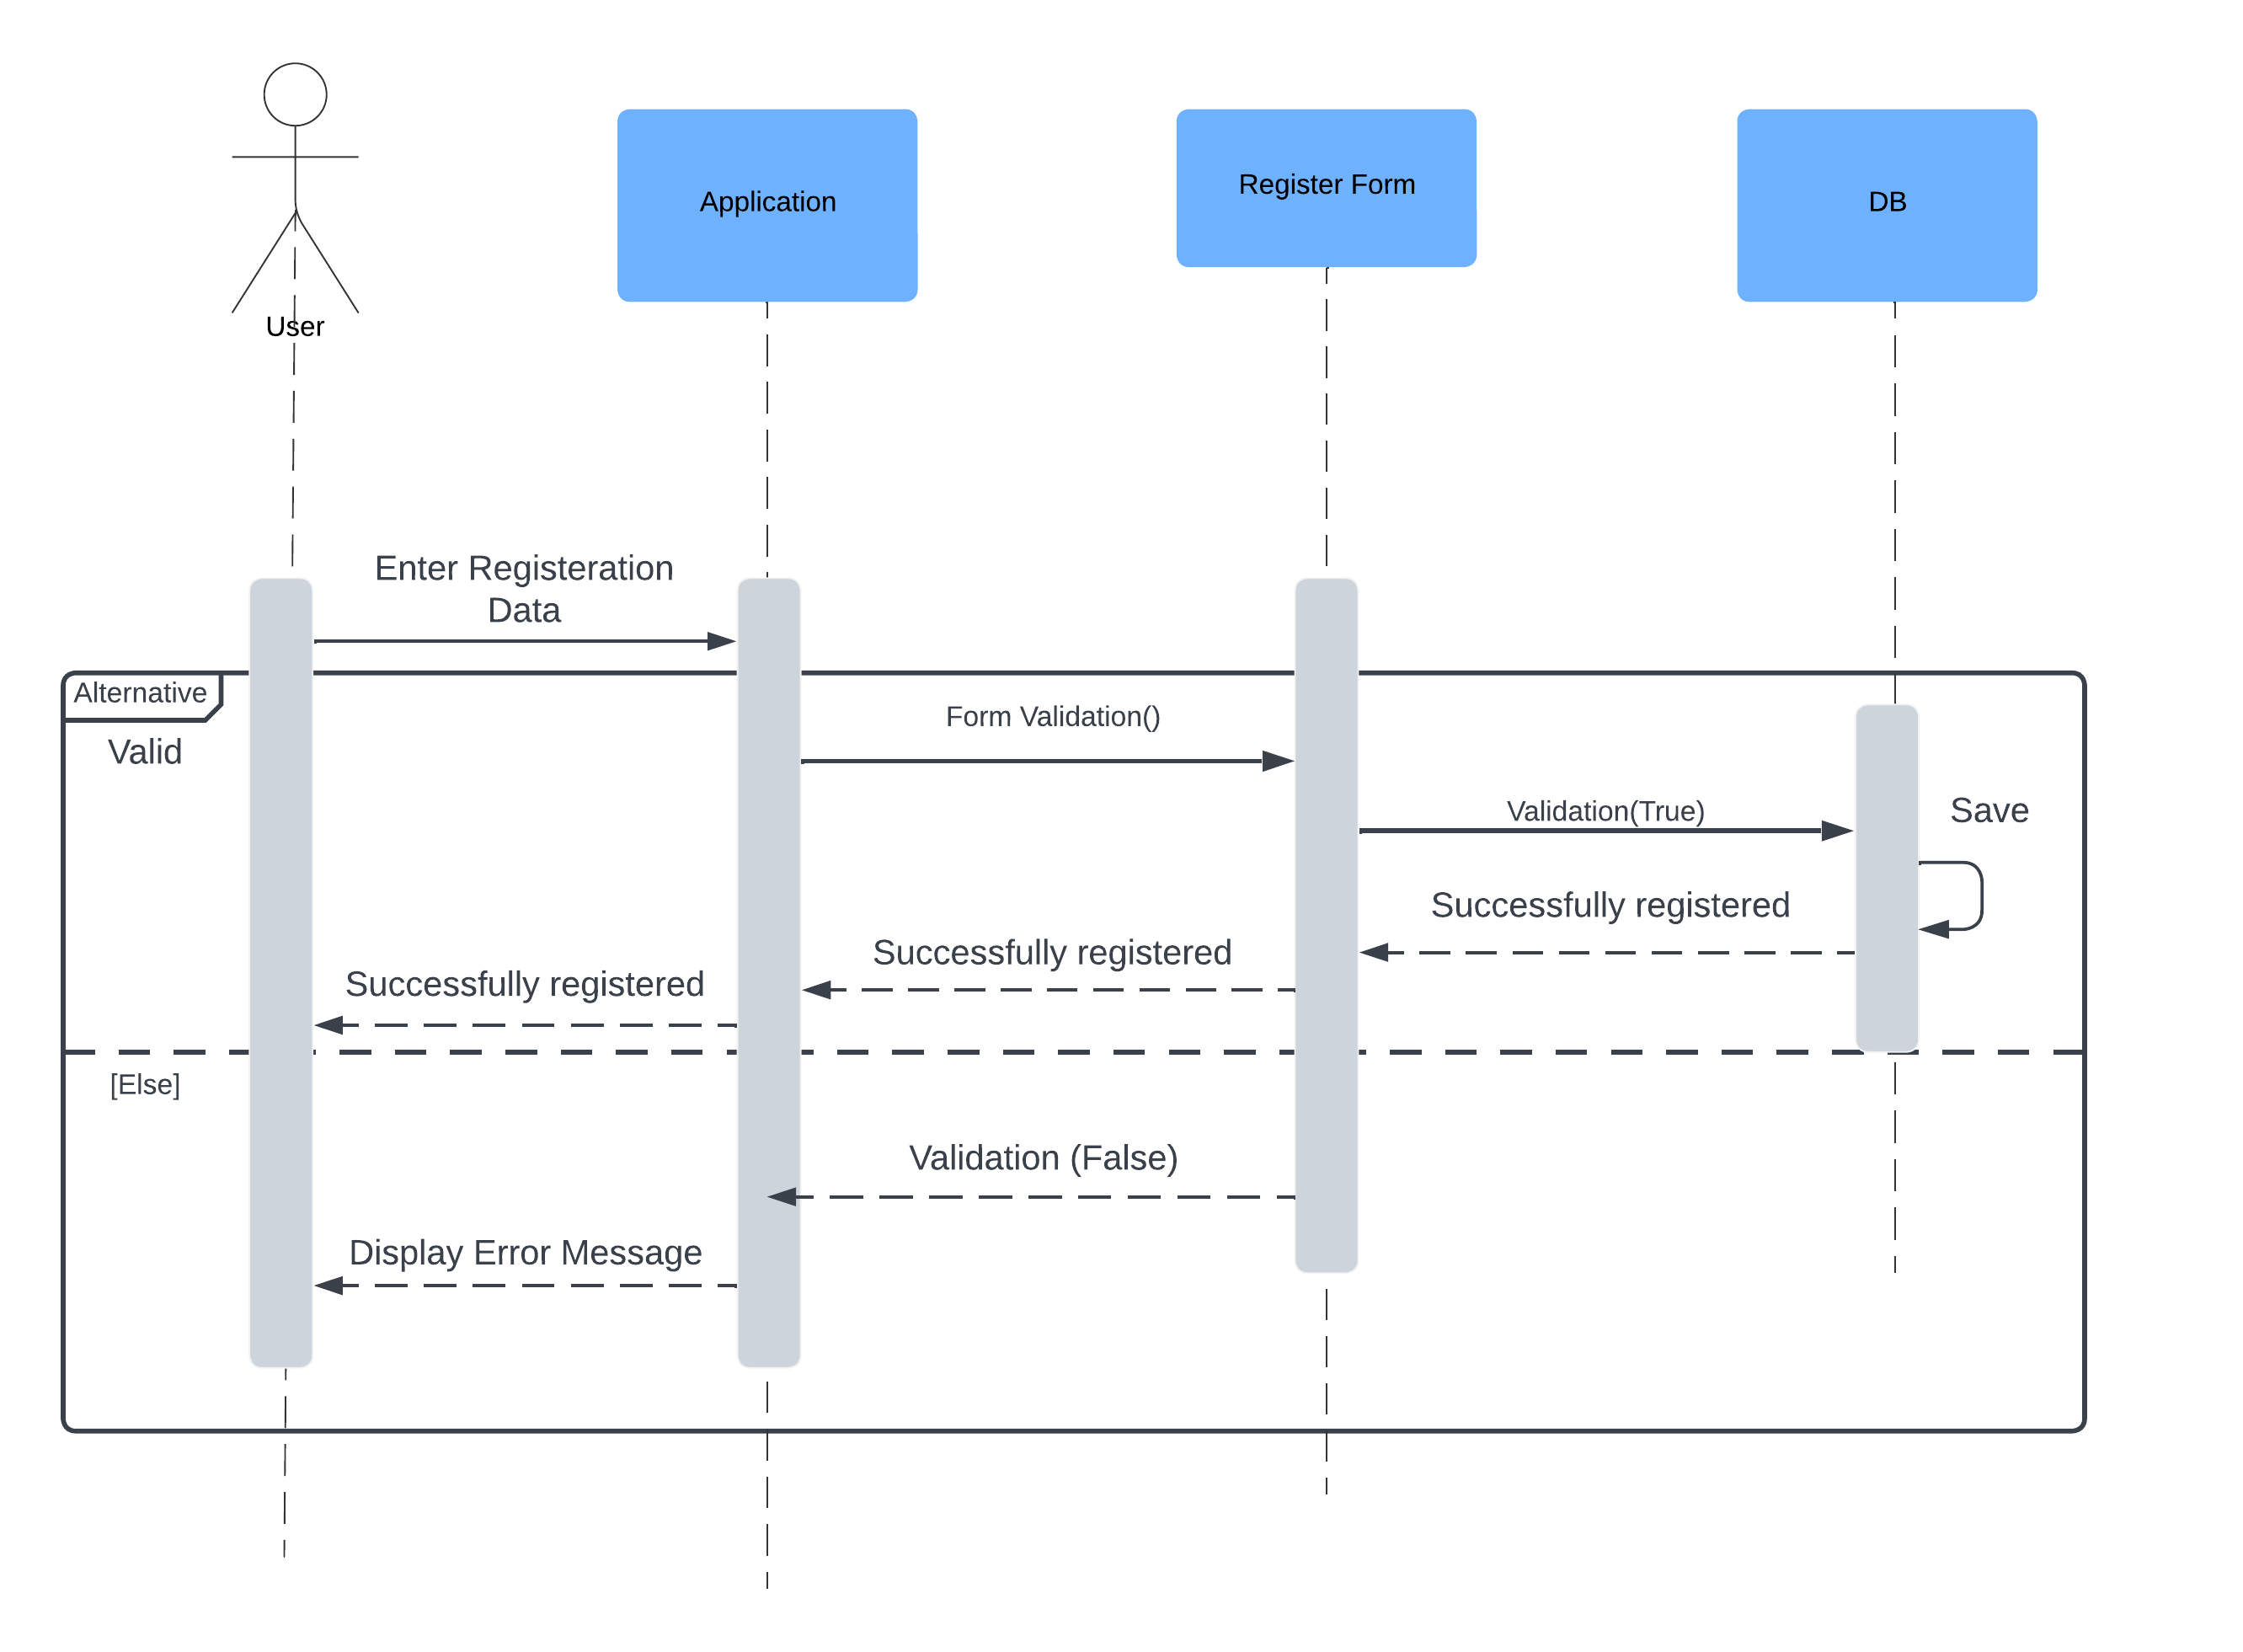
UML (Sequence Diagram)
Registration Sequence Diagram
Login Sequence Diagram
update account Sequence Diagram

Slide 21
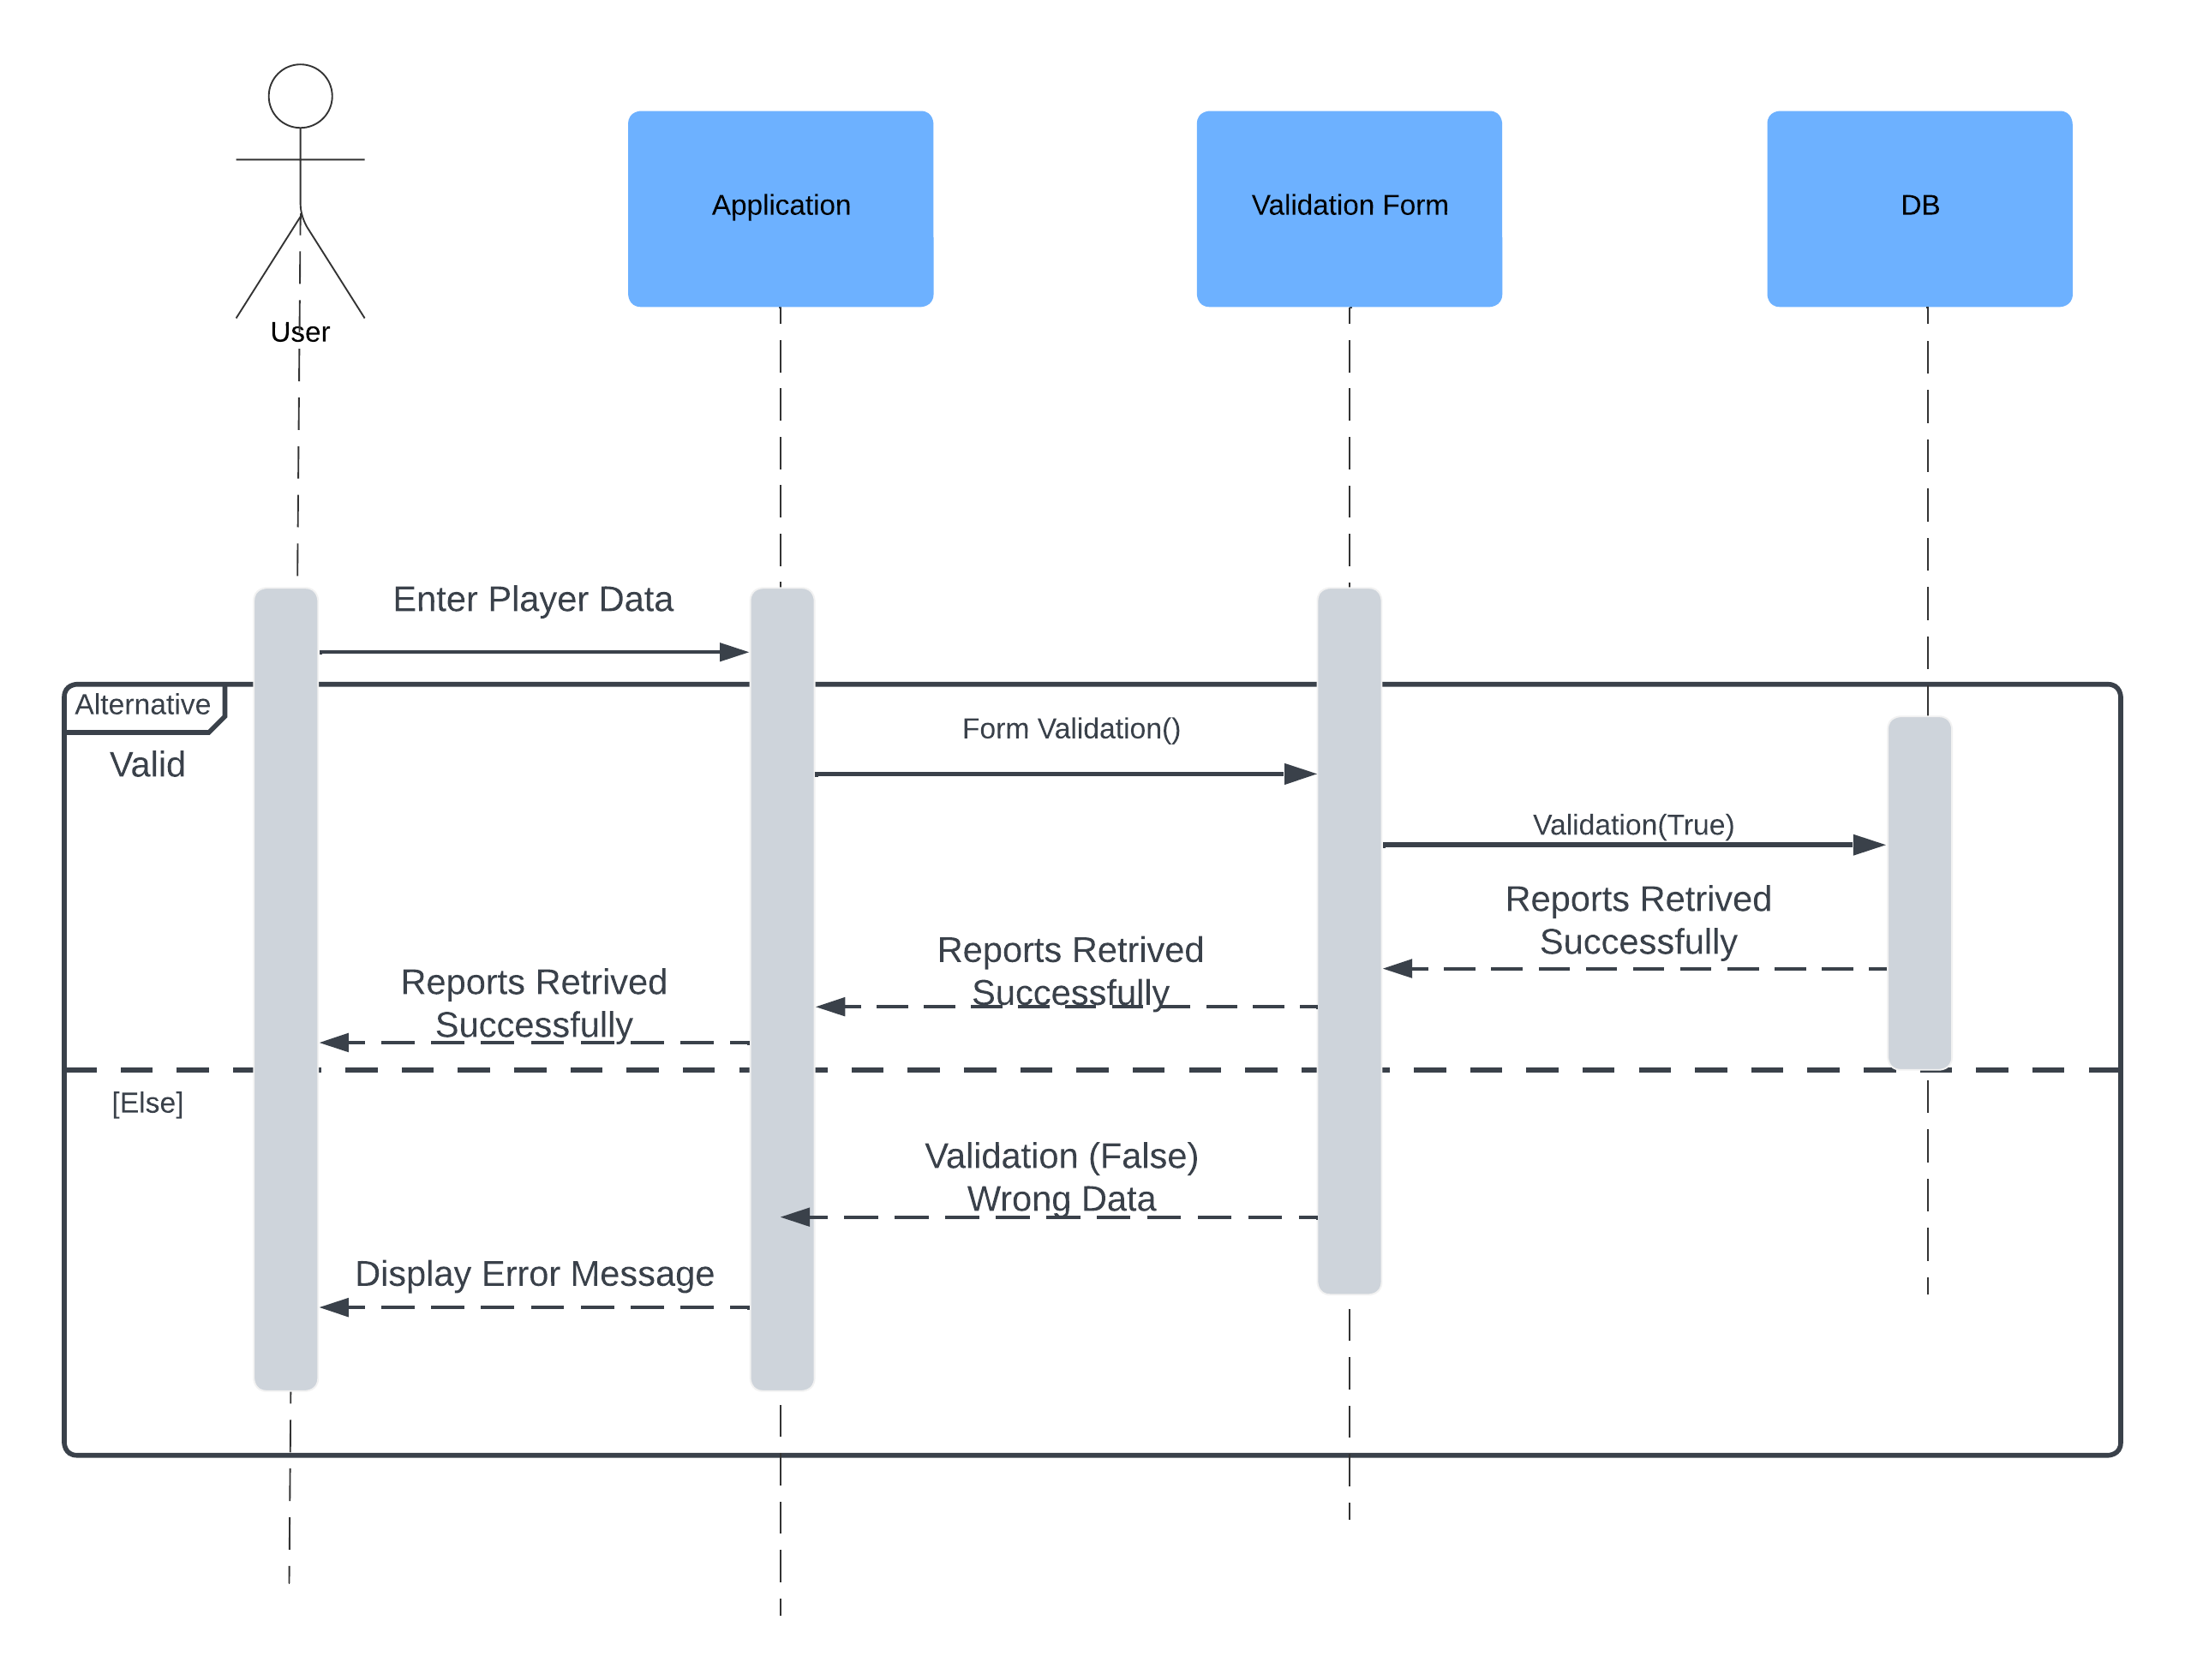
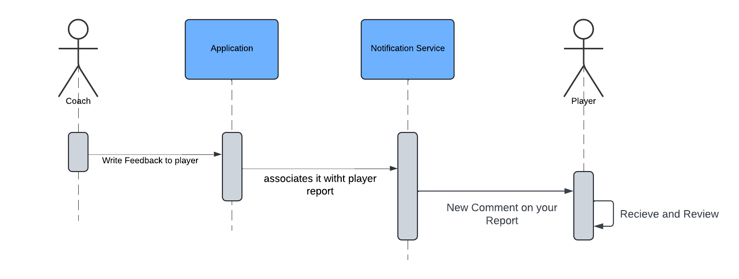
UML (Sequence Diagram)
Receive Feedback Sequence Diagram
Review Report Sequence Diagram

Slide 22
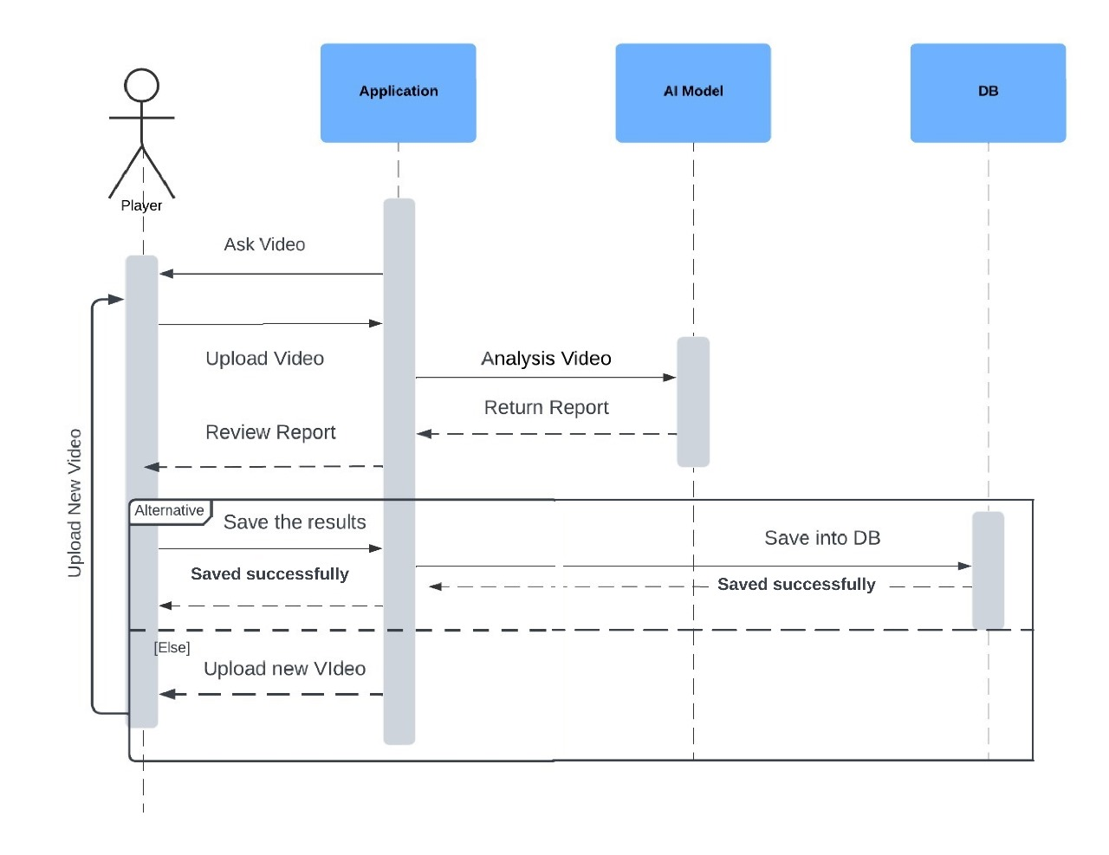
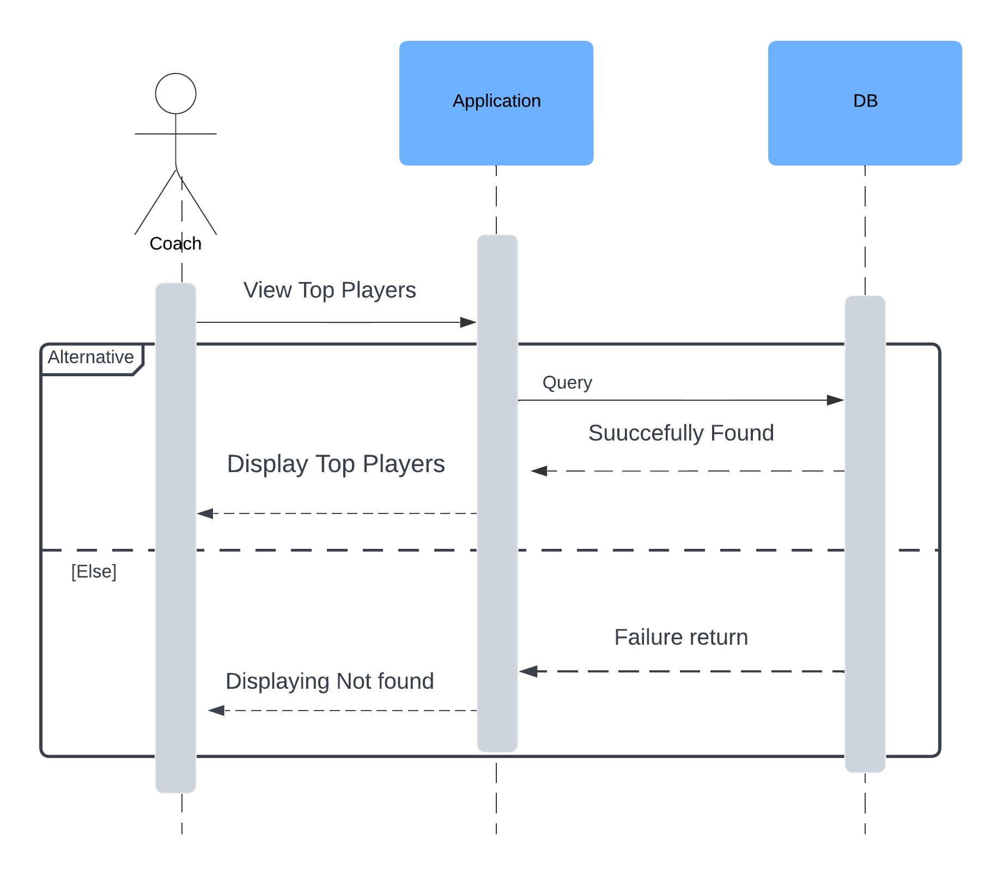
UML (Sequence Diagram)
Upload Video Sequence Diagram
View Top Players Sequence Diagram

Slide 23
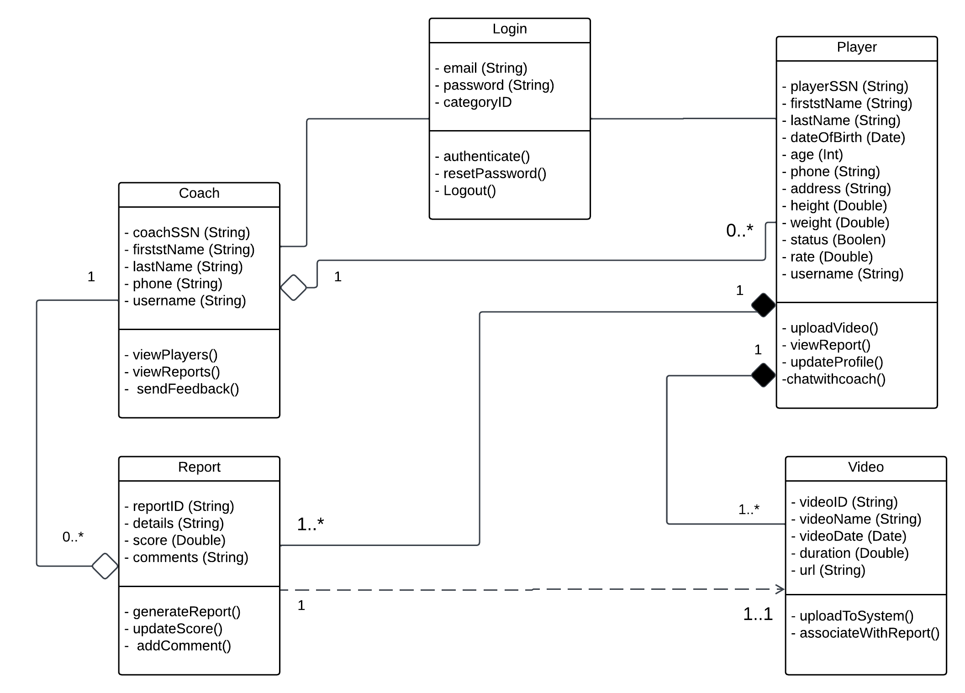
UML (Class Diagram)

Slide 24
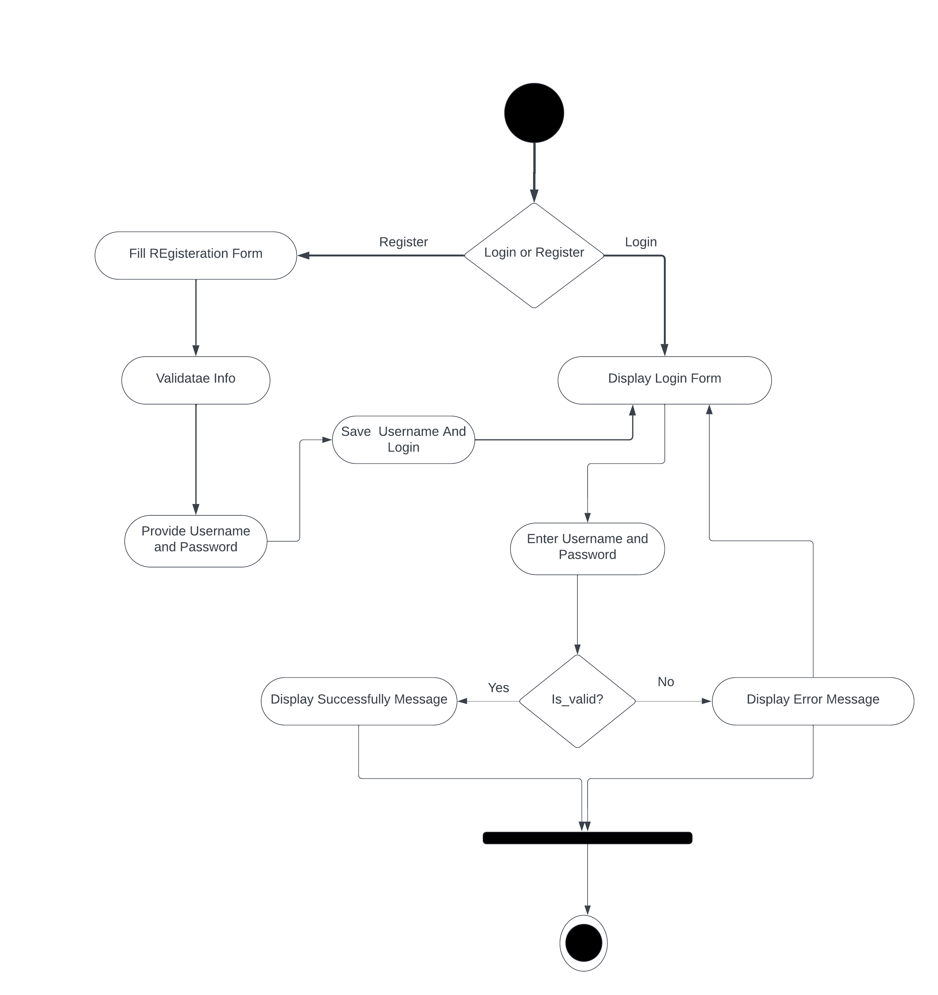
UML (Activity Diagram:all ayatem)

Slide 25
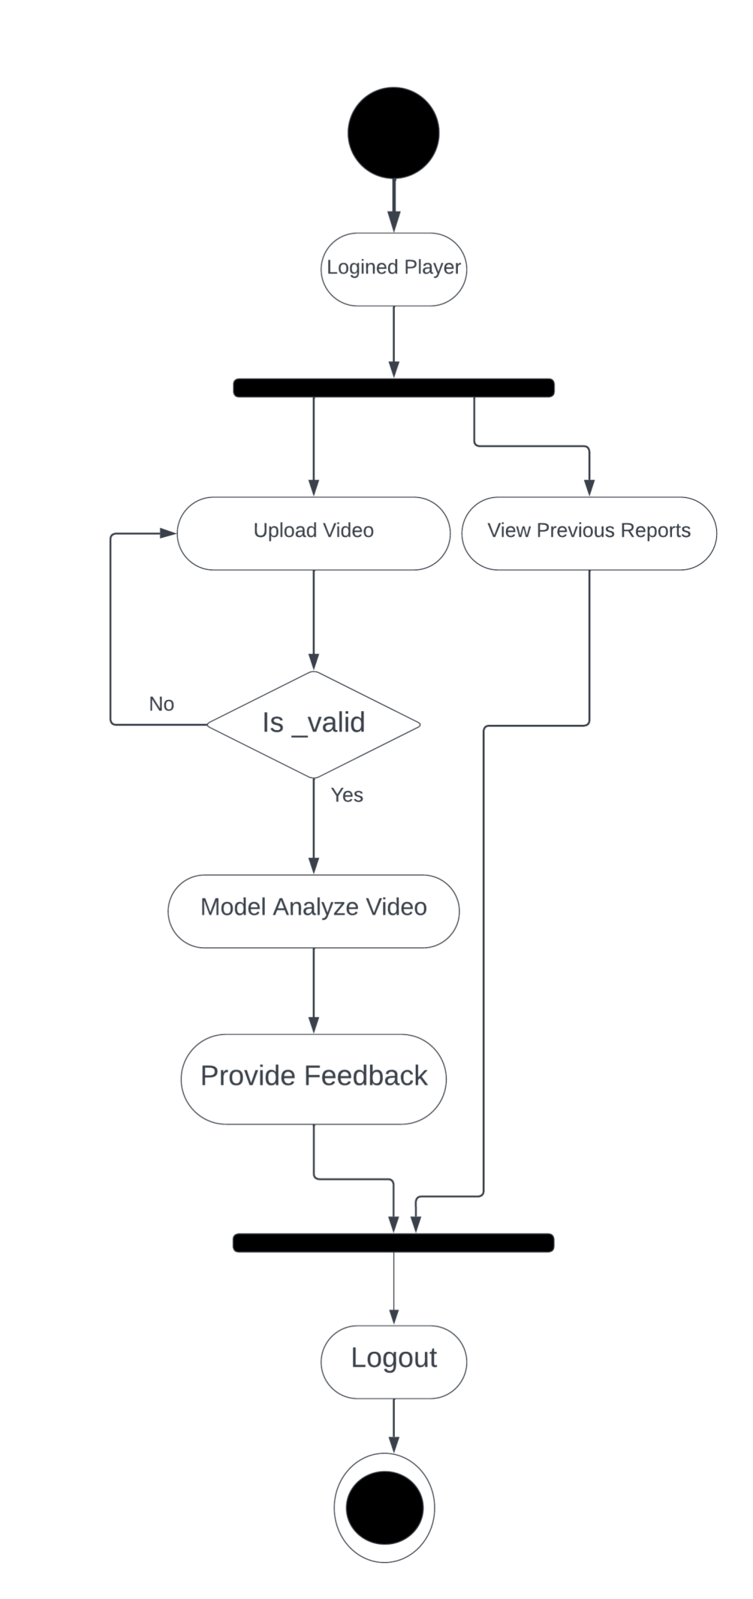
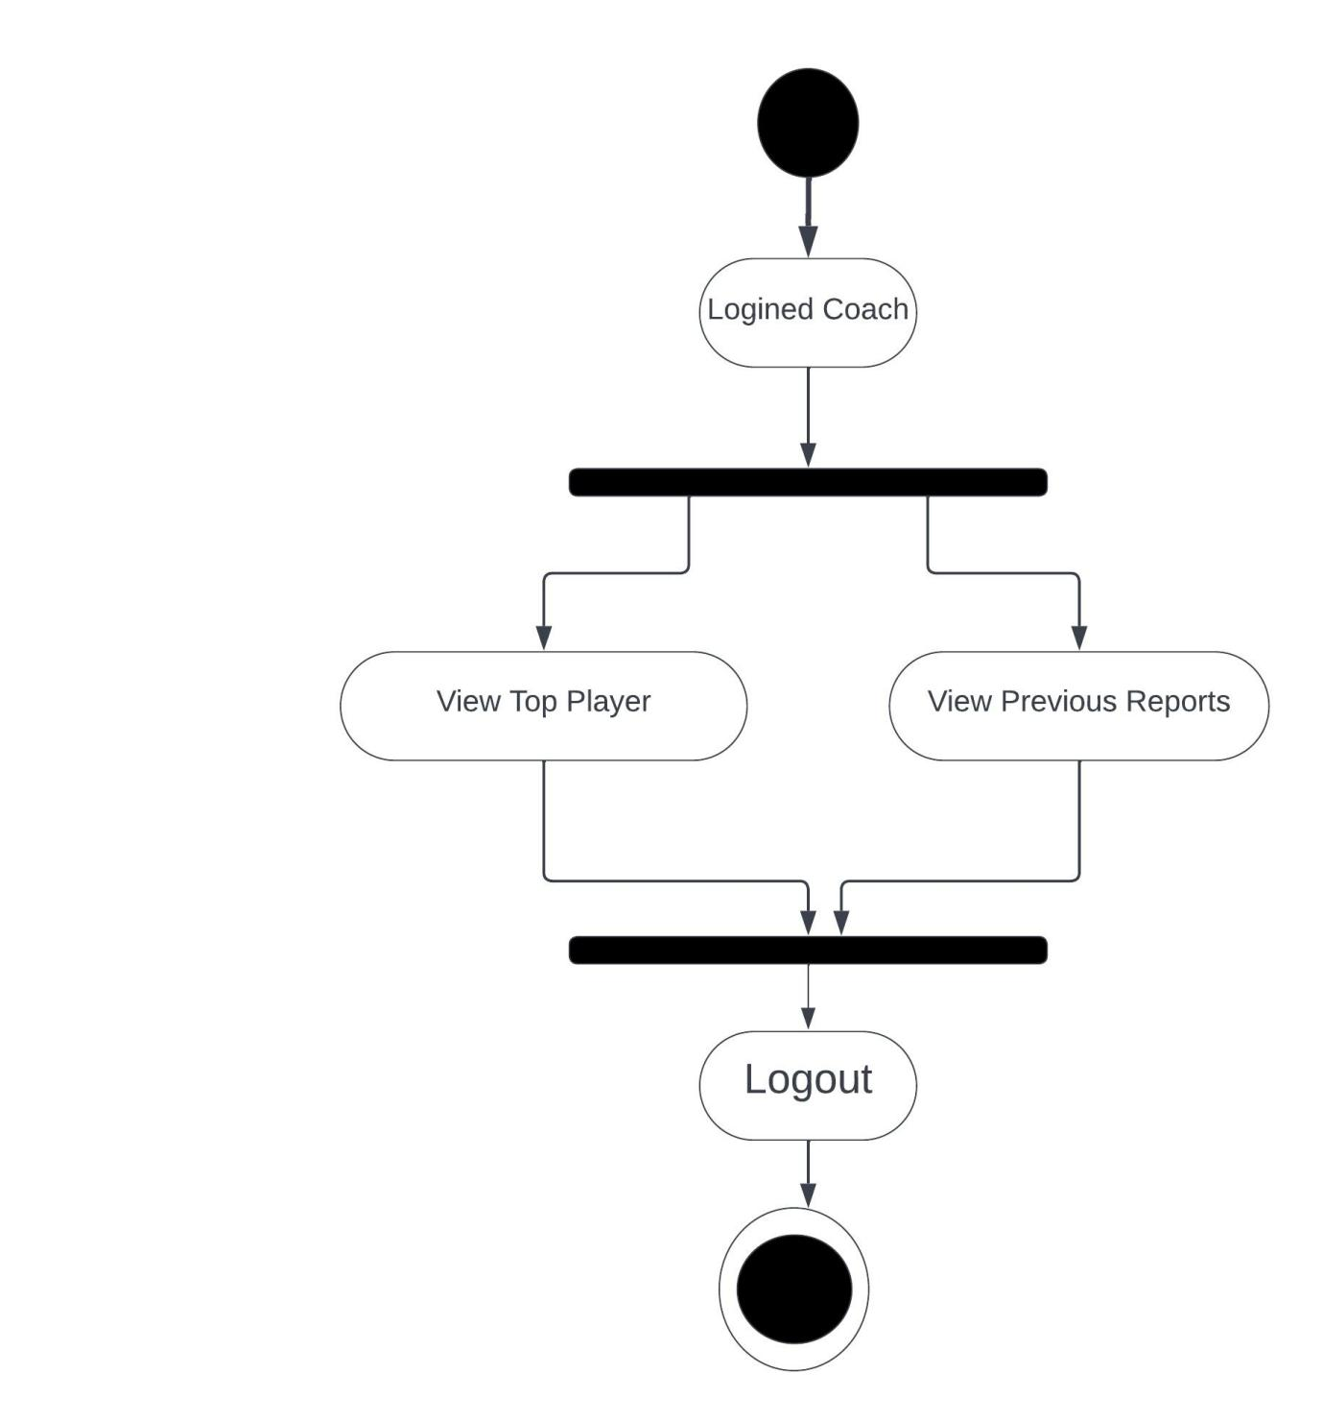
UML (Activity Diagram :login player and coach)

Slide 26
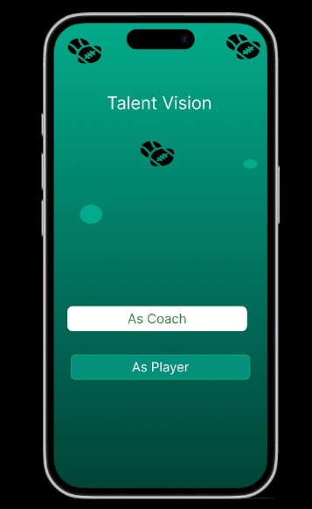
UI/UX Design
Our Home Page
selected page
The main entry point of the platform, offering a simple navigation choice for player and coach to access their respective functionalities

Slide 27
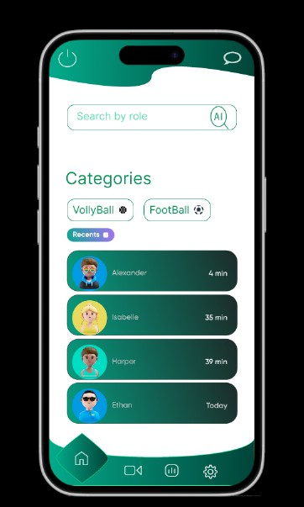
UI/UX Design
chattingPage
On this page we save the conversations that took place between the player and the coach where he has to get them instead of searching again to play.

Slide 28
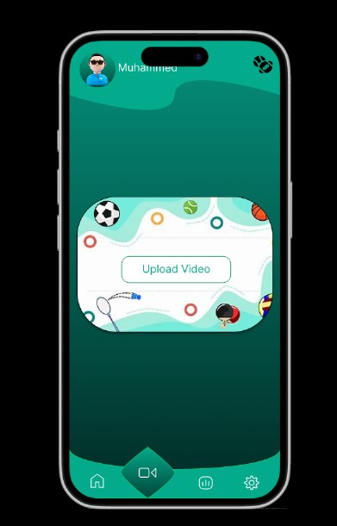
UI/UX Design
Upload Video Page

Slide 29
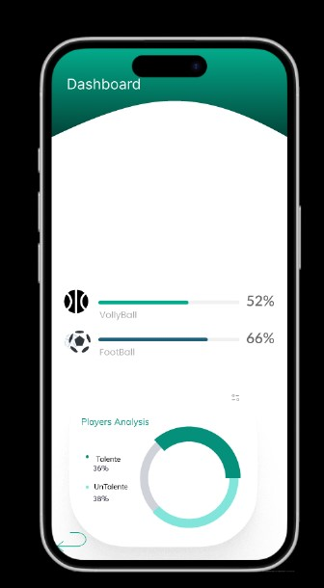
UI/UX Design
Dashboard form
On this page we do the categories in terms of sports and also the percentages for each of them and any of them that are the most present on the system

Slide 30
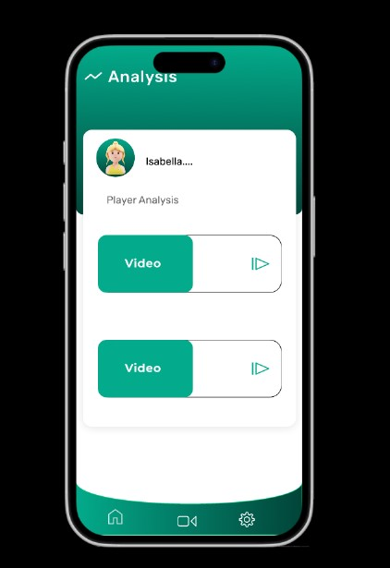
UI/UX Design
video analysis message
On this page we collect videos by the player or coach to enter them into the model and save them

Slide 31
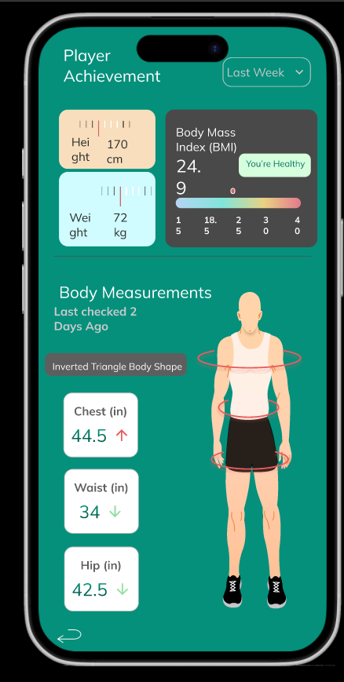
UI/UX Design
show analysis Page
In this page we are determined to clarify the performance of the player by continuing and sending the results that were analyzed to him with any modifications

Slide 32
Implementation Tools
Backend Development
Ai Tools:
Yolo: A fast object detection algorithm that identifies and locates objects in images in a single pass.
Pytroch: An open-source machine learning library for building and training deep learning models with dynamic computation graphs
Dot-Net:
Framework: A Microsoft-powered development framework used for back-end development.
Core Functionality: Ideal for building APIs, connecting to databases, and creating scalable enterprise systems.
Security: Provides advanced security features, including authentication (OAuth, OpenID Connect) and role-based access control.
Performance: Optimized for high-performance and scalable applications with support for asynchronous programming.
Multi-Platform: Cross-platform support via .NET Core/.NET 6+ for Windows, macOS, and Linux.
Database Integration: Simplifies database operations using Entity Framework (ORM) and supports multiple databases (SQL Server, MySQL, PostgreSQL).
Cloud Integration: Seamlessly integrates with Microsoft Azure and other cloud platforms for scalable deployment.
Best Use Case: Ideal for building RESTful APIs, microservices, and enterprise-grade back-end systems.Frontend Development
Flutter or KMP:
Flutter: Flutter is an open-source UI toolkit developed by Google for building natively compiled applications for mobile, web, and desktop from a single codebase.
KMP: Kotlin Multiplatform (KMP) is a framework by JetBrains that enables developers to share code across multiple platforms (iOS, Android, web, and desktop) while allowing platform-specific implementationsDatabase Management.
MySQL:
An advanced relational database that supports efficient handling of complex and distributed data.
Used to store patient information, health records, and incubator reservation data.
UI/UX Design Tools
Figma:
A design tool for creating UI and prototypes.
Allows team collaboration and direct interaction with designs during the development phase.

Slide 33
Expected Outcome (Including SDGs)
The project also aligns strongly with global Sustainable Development Goals (SDGs), particularly:
SDG 4: Quality Education
How it aligns:
Talent Vision promotes education and learning in sports by providing athletes with AI-driven feedback and progress-tracking tools. The app fosters skill development and self-improvement, contributing to their overall personal growth.
SDG 5: Gender Equality
How it aligns:
The app ensures inclusivity by offering equal opportunities for both male and female athletes to showcase their talents, regardless of their gender or location.
SDG 8: Decent Work and Economic Growth
How it aligns:
By modernizing the talent discovery process, Talent Vision creates opportunities for athletes to secure professional careers. It also fosters growth in the sports industry by connecting talent with scouts and coaches efficiently.
SDG 10: Reduced Inequalities
How it aligns:
Talent Vision breaks barriers by making talent discovery accessible to underprivileged athletes across the Arabian community. Its free and inclusive platform reduces economic and geographical inequalities in the scouting process.
SDG 11: Sustainable Cities and Communities
How it aligns:
By promoting local athletic talent and providing opportunities for recognition, Talent Vision strengthens community bonds and contributes to the development of vibrant sports ecosystems within cities and regions.
SDG 17: Partnerships for the Goals
How it aligns:
Talent Vision fosters partnerships between athletes, coaches, scouts, and sports organizations, creating a collaborative network to enhance the sports talent ecosystem and achieve common development goals

Slide 34
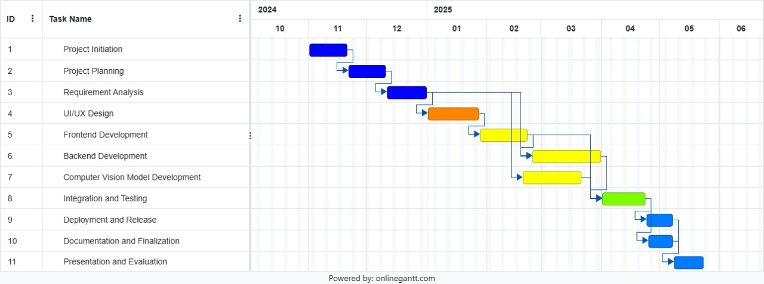
Project Plan (Gantt Chart)

Slide 35
Conclusion
In conclusion, alent Vision redefines athletic talent discovery by offering an innovative, accessible, and inclusive solution. Through AI-driven video analysis, progress tracking, and professional feedback, the app empowers athletes to showcase their skills and connects them with scouts seamlessly.
It eliminates barriers like cost and geography, making opportunities accessible to underrepresented athletes across the Arabian community. By aligning with the Sustainable Development Goals, Talent Vision promotes fairness, equality, and collaboration in sports.
More than just an app, Talent Vision is a transformative platform that inspires ambition, connects talent, and builds a brighter future for athletes, shaping the sports industry for generations to come.

Slide 36
References (IEEE Format)
[1] "The role of AI in sports performance analysis," available on Google Scholar and ResearchGate.
[2] "Impact of technology on talent identification in sports," Journal of Sports Science.
[3] Hudl, "Transforming athlete development through video analysis," [Online]. Available: www.hudl.com.
[4] Coach's Eye, "Use-case studies on Coach's Eye in coaching," [Online]. Available: Coach’s Eye.
[5] Dartfish, "Dartfish technology in athletic performance improvement," [Online]. Available: Dartfish.
[6] HomeCourt, "AI in basketball performance analysis," [Online]. Available: HomeCourt.
[7] Trace Soccer, "Tracking athletes using video and GPS," [Online]. Available: Trace Soccer.
[8] OpenScout, "OpenScout football talent discovery," LinkedIn articles and case studies, [Online]. Available: Search terms: "OpenScout football talent discovery."
[9] "Action recognition using deep learning: Applications in sports analytics," IEEE Transactions on Artificial Intelligence.
[10] "AI techniques for performance evaluation in team sports," IEEE Conference Proceedings.
[11] "Predicting sports performance metrics using AI," Journal of Sports Analytics.
[12] "Digital progress tracking in individual sports," available in academic databases.
[13] "Collaborative coaching platforms using AI and video analytics," Journal of Coaching Technology.

Slide 37


